Slide 1
Applied Materials
Idit Cohen – Home test

Slide 2

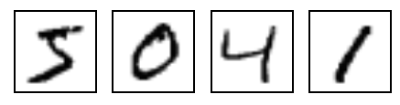
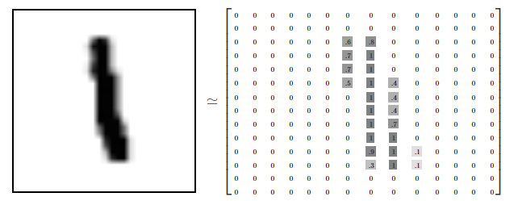
Dataset characteristics
MNIST is a computer vision dataset.
It consists of 28x28 pixel images of handwritten digits, such as:
Every MNIST data point is an image that can be thought of as an array of numbers describing how dark each pixel is. For example, the digit 1 locks something like that →
[1] https://colah.github.io/posts/2014-10-Visualizing-MNIST/

Slide 3
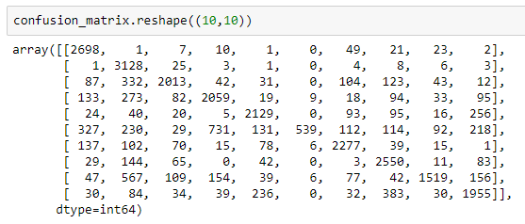
Dataset generation for anomaly detection
The objective is to maximizing the difficulty of telling the two sets (normal and anomalous) apart
Step 1: Training a Random Forest to solve the multi-class classification problem
Step 2: Calculate the amount of confusion between each class by using confusion matrix
[2] http://www.outlier-analytics.org/odd13kdd/papers/emmott,das,dietterich,fern,wong.pdf

Slide 4
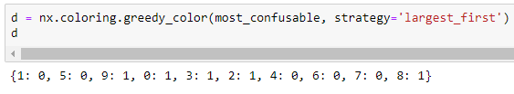
Dataset generation for anomaly detection tasks
Step 3: Calculate the (unnormalized) probability that a data point in class j will be confused with a data point in class k by generating a graph in which each node is a class and each edge (between two classes j and k) has a weight equal to C[j, k] + C[k, j]
Step 4: compute “most-confusable” relationships between pairs of classes by the maximum weight spanning tree of this graph [3]
Step 5: Two-colour the tree so that no adjacent nodes have the same colour to define the two sets of points [4]
[3]https://networkx.github.io/documentation/latest/reference/algorithms/generated/networkx.algorithms.tree.mst.maximum_spanning_tree.html
[4]https://networkx.github.io/documentation/latest/reference/algorithms/generated/networkx.algorithms.coloring.greedy_color.html

Slide 5
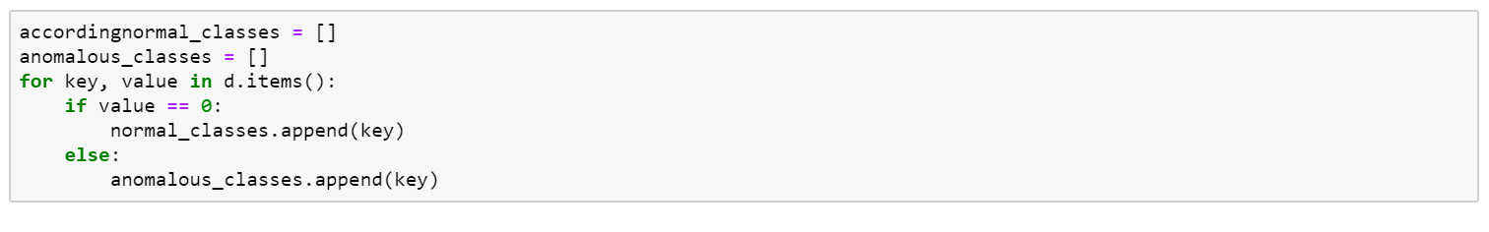
Dataset generation for anomaly detection tasks
Step 6: Set 0 as “normal” and 1 as “anomalous” according to d
Step 7: Randomly down sample the “anomalous” set to 5%

Slide 6
preprocess of data
No missing data
Normalize the data [10]

Slide 7
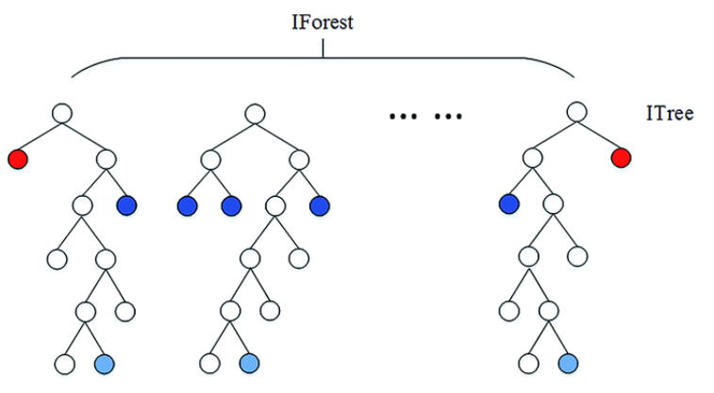
Benchmark methods - Isolation Forest
Randomly selecting a feature and then randomly selecting a split value between the maximum and minimum values of the selected feature
Averaged the number of splitting required to isolate a sample over a forest of such random trees
Shorter path lengths for a sample, indicates higher likelihood to be anomaly
[6] https://scikit-learn.org/0.20/modules/generated/sklearn.ensemble.IsolationForest.html#sklearn.ensemble.IsolationForest
[7] https://donghwa-kim.github.io/iforest.html

Slide 8
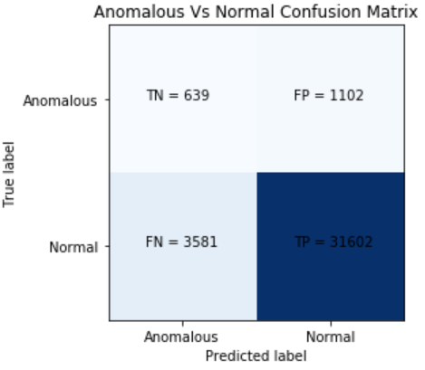
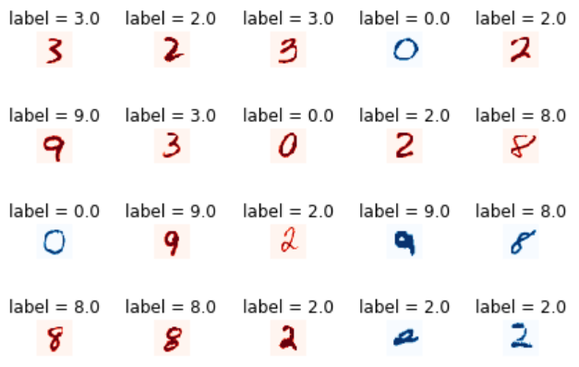
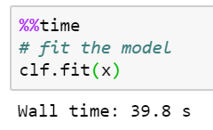
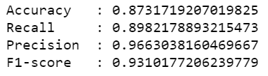
Isolation Forest - Results

Slide 9
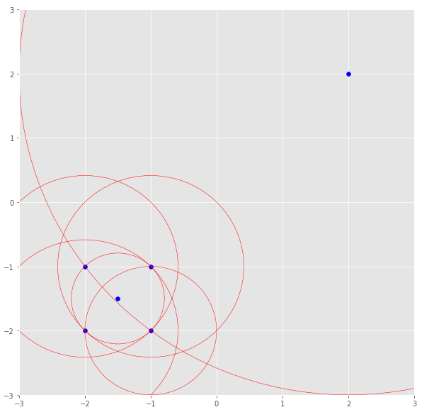
Benchmark methods - Local Outlier Factor (LOF)
Algorithm for finding anomalous data points by measuring the local deviation of a given data point with respect to its neighbors
Calculate the local reachability density
Calculate the distance of point a to all its k nearest neighbors
Take the average of the k distances
Inverse the average
The LOF of a point is the density of the point compared to the density of its neighbors.
If the density of a point is much smaller than the densities of its neighbors (LOF ≫1), the point is far from dense areas and, hence, an outlier.
[5] https://towardsdatascience.com/local-outlier-factor-for-anomaly-detection-cc0c770d2ebe

Slide 10
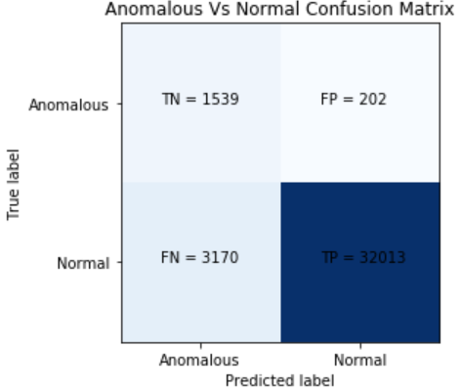
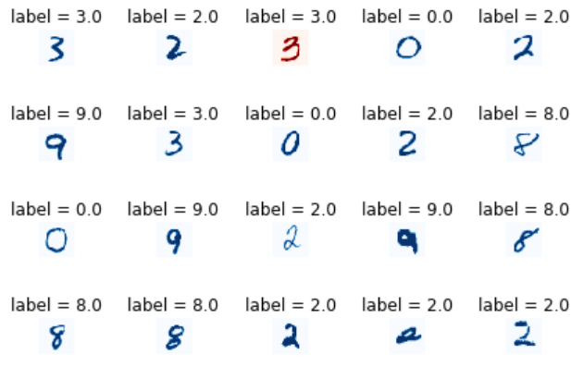
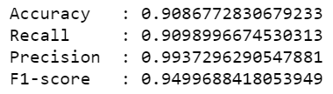
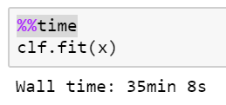
Local Outlier Factor - Results

Slide 11
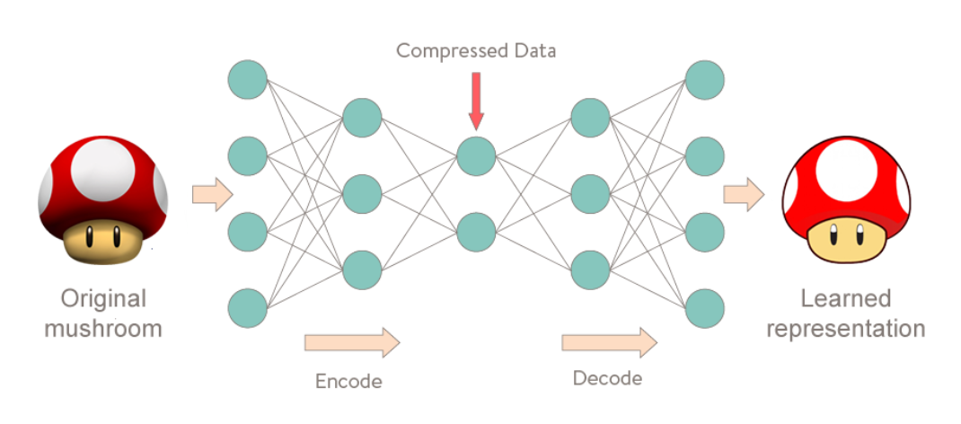
Benchmark methods - AutoEncoder NN
An autoencoder is a type of artificial neural network used to learn efficient data coding in an unsupervised manner.
The module is trained by calculating the loss between the output and the input using only the “normal” dataset
New samples using the model, will be identified as “anomalous” if the loss is large
[9] https://medium.com/@curiousily/credit-card-fraud-detection-using-autoencoders-in-keras-tensorflow
-for-hackers-part-vii-20e0c85301bd

Slide 12
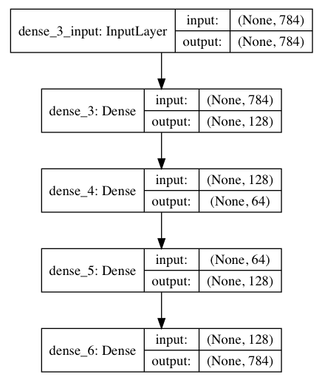
Benchmark methods - AutoEncoder NN
I built AutoEncoder neural network based on GitHub example [8]
I trained the model with the Normal dataset and predict the abnormal
I set the loss threshold at 0.03. A sample with Loss above the threshold is classified as Abnormal
[8] https://github.com/otenim/AnomalyDetectionUsingAutoencoder

Slide 13
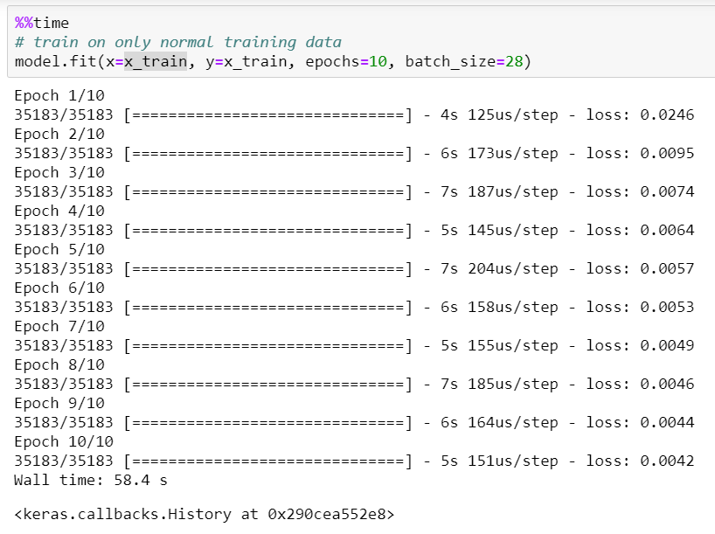
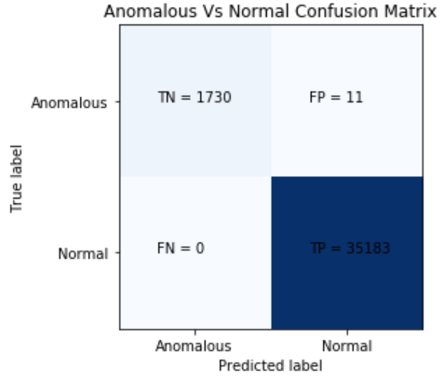
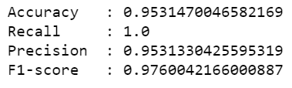
AutoEncoder NN - Results

Slide 14

Isolation Forest – Best Results, applicable time
Local Outlier Factor
Isolation Forest
Autoencoder Neural Network

